Slide 1




Git Protocol and Github 101
Sarang Parikh
Order of Satoshi | Blockchain at NMIT
Notes:
http://www3.weforum.org/docs/WEF_The_future_of_financial_infrastructure.pdf

Slide 2

GitHub | Order of Satoshi
GITHUB

Slide 3
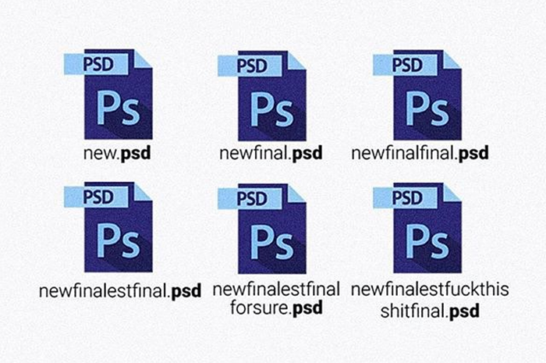

GitHub | Order of Satoshi
I am sure you have done this once in your life…

Slide 4
GitHub | Order of Satoshi
Definition of Git
Git is a free and open source distributed code management and version control system.
Linus Torvalds, the creator of Linux, developed and released Git in 2005.
The project was originally undertaken because available open source version control systems at that time weren't up to up to the requirements of Linux kernel development.
For one thing, version control for such a large-scale collaborative effort requires better performance than available systems were capable of -- three seconds to apply a patch, for example, versus 30.
In addition to its superior performance, Git provides support for a distributed workflow and safeguards against corruption.

Slide 5
GitHub | Order of Satoshi
What is Version Control?
Version control systems are a category of software tools that help a software team manage changes to source code over time
Version control software keeps track of every modification to the code in a special kind of database
If a mistake is made, developers can turn back the clock and compare earlier versions of the code to help fix the mistake while minimizing disruption to all team members.

Slide 6

GitHub | Order of Satoshi
Are Git and Github same?

Slide 7

GitHub | Order of Satoshi
Git and Github
Git is a protocol whereas Github is an implementation of that protocol which runs over cloud and provide much higher collaboration and team maintenance capability.
Some other examples of similar websites are: -
Gitlab, Sourceforge, etc.
Github is so popular that we often use Git and Github in the same context.

Slide 8

GitHub | Order of Satoshi
All of you right now….. Let’s Start the Hands on

Slide 9
GitHub | Order of Satoshi
Installation
Linux:
Go to the terminal -> sudo apt-get install git
Windows:
Google -> Git Bash -> Install via Wizard.
Verify:
$git –v
Configure:
$ git config --global user.name “sarang”
$ git config –global user.email “sarangparikh22@gmail.com”

Slide 10
GitHub | Order of Satoshi
Creating the Repository

Slide 11
GitHub | Order of Satoshi
Working with Repository
The git add command adds a change in the working directory to the staging area
$ git add <file>/<directory>
The git status command shows the status of the files that needs to be updated in to the repository
$ git status
The git commit command commits the staged snapshot to the project history (saves into the repository)
$ git commit

Slide 12
GitHub | Order of Satoshi
Working with Remote Repository
The git remote command lets you create, view, and delete connections to other repositories.
$ git remote add <name> <url>
Remove the connection to the remote repository called <name>
$ git remove <name>
To rename the remote repository issue the command
$ git remote rename <old-name> <new-name>
To push the local repository into remote repository
$ git push -u my_local_repo master

